Slide 1

PetaFlop
Team Members
Karthik Venukumar 248792
Niranj Rajesh 248753
Uma A M 248765
Varsha T R 248777
Team Mentor
Kevin Jacob
Arun Suresh kumar
Roshan

Slide 2
Index
01
Introduction
04
Technology
07
Frontend & Backend
Database Design
Tracking our steps
02
Problem Statement
05
08
03
Wireframe
06
API Endpoints
09
Conclusion

Slide 3
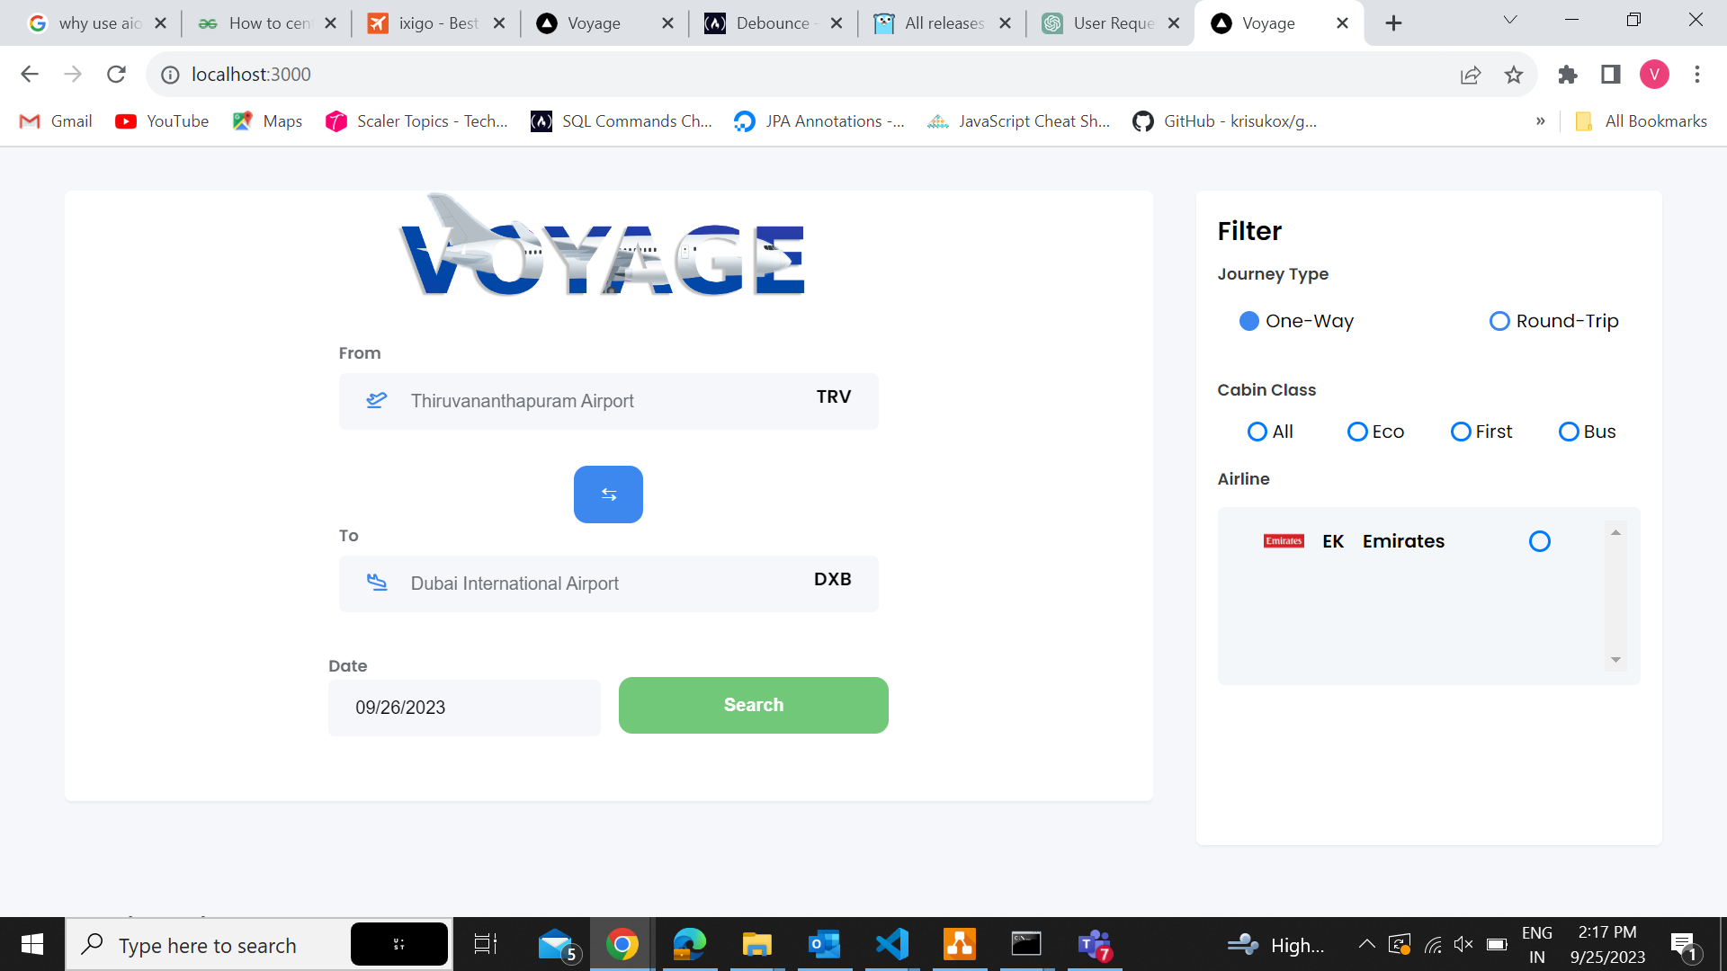
Introduction
Imagine a world where your travel preferences are effortlessly transformed into tailored airline route options. Today, we unveil our solution to make that a reality. Get ready to explore airline routes quickly, easily, and on your terms.
“Empowering Travel Planning”

Slide 4
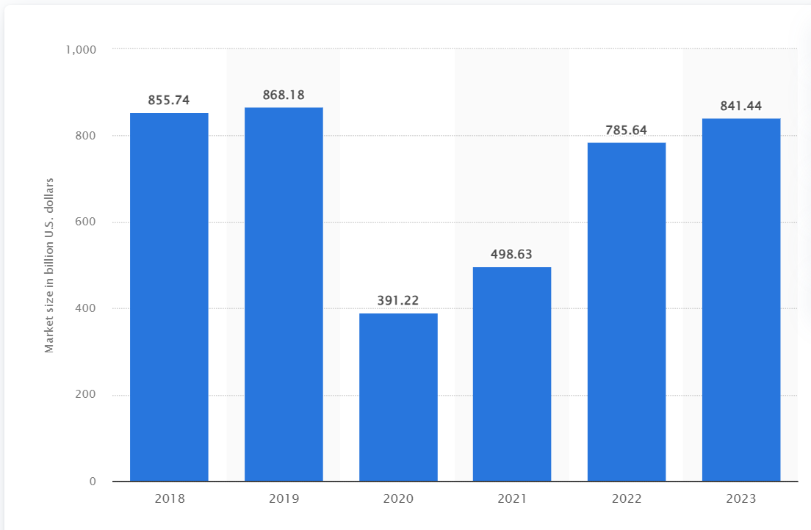
Market size of the airline industry worldwide from 2018 to 2023
By 2036 the air transport industry will then contribute 15.5 million in direct jobs and $1.5 trillion of GDP to the world economy-ICAO
Source: Statista Research Department July-23

Slide 5
Problem Statement
Create a comprehensive solution that will enable users to explore airline route results quickly and easily in accordance with their preferences.

Slide 6


Slide 7
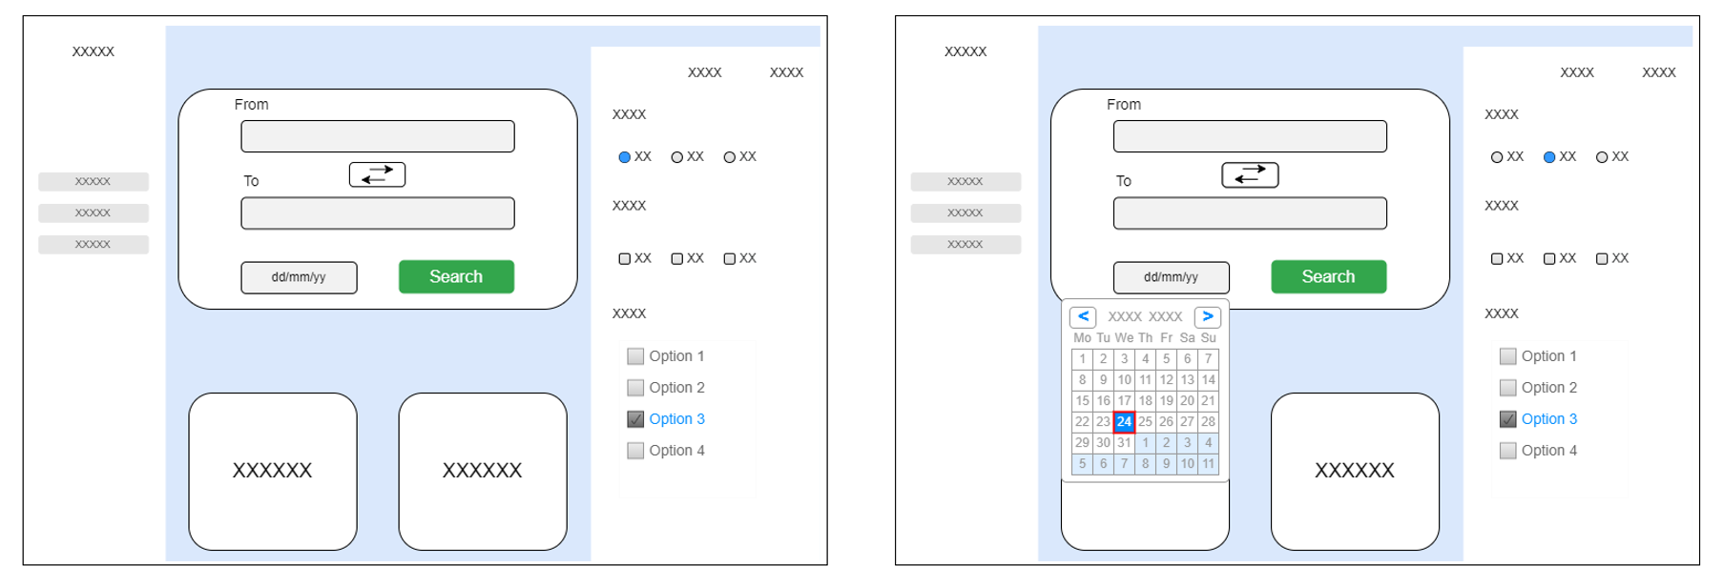
WIREFRAME

Slide 8
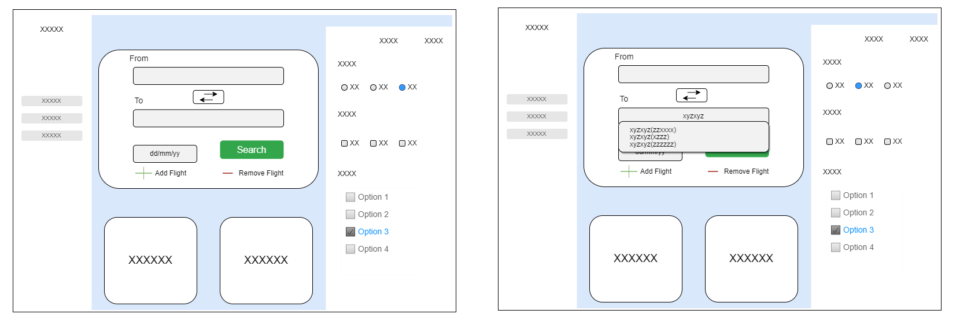
WIREFRAME

Slide 9
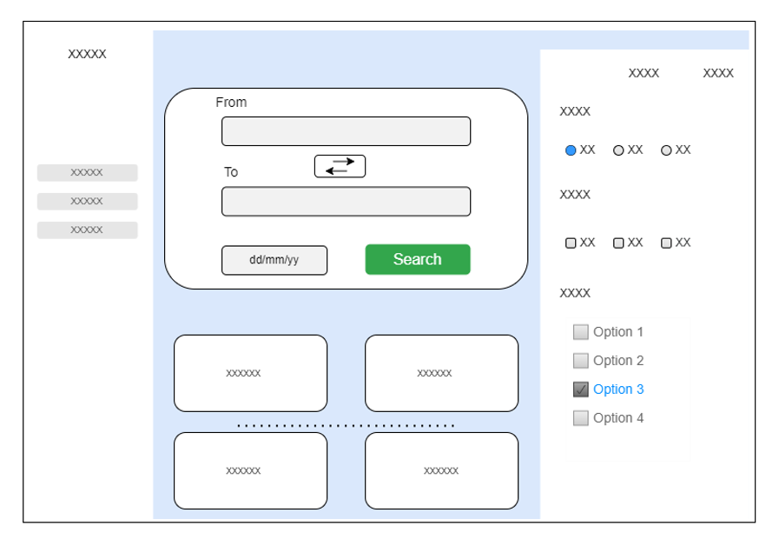
WIREFRAME

Slide 10






Technology
Go
MongoDb
Next.js
Sass
TypeScriopt
Material-ui

Slide 11
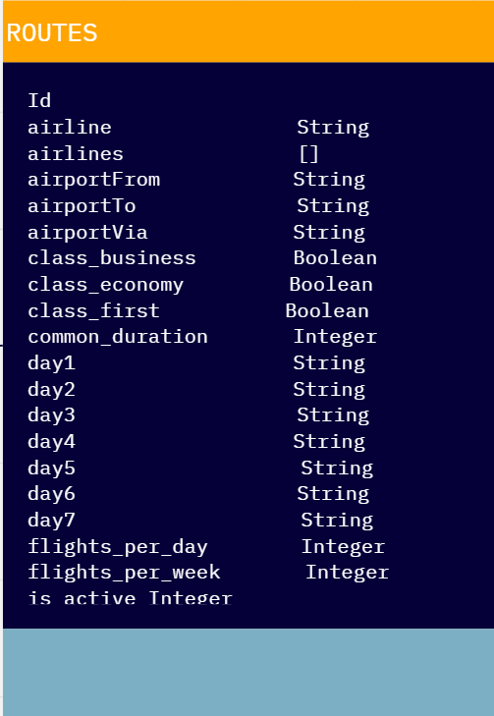
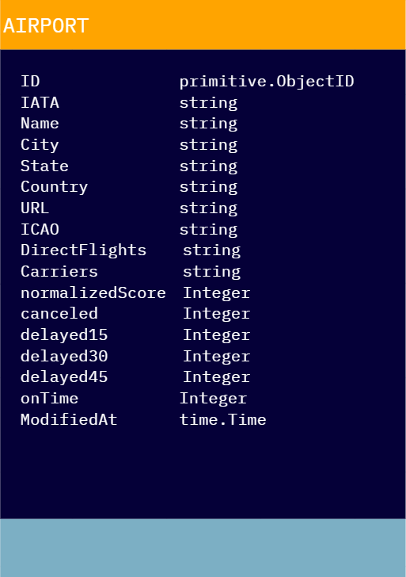
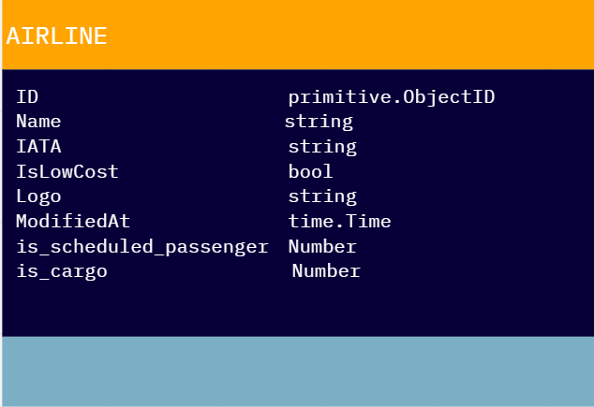
Data-Base Design

Slide 12
API Endpoints
GET | /api/airport/airport_iata | ...enables users to search for flights using the IATA code of an airport
GET | /api/airline/airline_iata | ...allows users to search for airport information using the IATA code
POST | /api/routes | ...detailed information about a specific flight route using its unique ID
POST | api/detailrecommendations | ...detailed information about a specific flight route using its arrival and departure airports
GET | /api/airportautocomplete?search_string=airport_iata | ...allows users to search for airports using an autocomplete feature.

Slide 13
Tracing Our Steps
Week-1
Problem identification
Database designing and data ingestion
Week-2
Backend designing
Backend development
Week-3
Frontend designing
Backend development

Slide 14
Conclusion
Today, we've introduced you to a world where travel planning is no longer a hurdle but a personalized journey. Our website, the realization of this vision, empowers you to:
Tailor Your Way: Customize your routes based on your preferences.
Simplify Planning: Eliminate the hassle of sifting through countless options.
Travel Your Way: Explore routes quickly, easily, and on your terms.
Your adventure awaits! Visit our website and let's redefine the way you travel. Welcome to a new era of travel planning!

Slide 15
Happy World Tourism day
September 27

